Slide 1
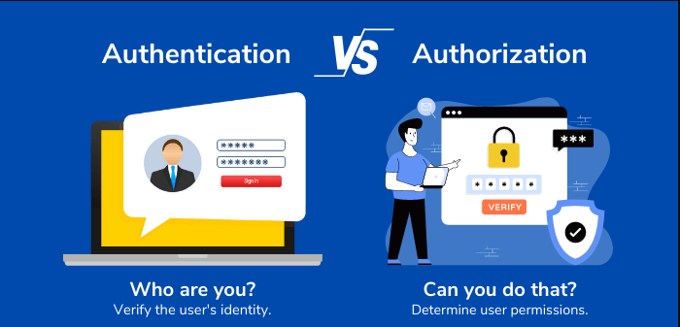
Authorization and Authentication
Section 1 : Group 9
Group Members Nitin Thakkar Prarthana Puranik Raj Panjwani
Big Data Analytics – BDAT1001

Slide 2
Project Summary
This Project shows how to create an ASP.NET Core web app with user data protected by authorization. It displays a list of contacts that authenticated (registered) users have created. There are three security groups:
Registered users can view all the approved data and can edit/delete their own data.
Managers can approve or reject contact data. Only approved contacts are visible to users.
Administrators can approve/reject and edit/delete any data.

Slide 3
Team Profile
Prarthana Puranik(Manager)
Nitin Thakkar(Admin)
Raj Panjwani (User)
Software Developer | BI Developer | Data Engineer With 6 Years of Experience
Embedded software Developer with 9 Years of Experience
Software Developer Intern | Python Developer

Slide 4
Part 1 : User data protected by authorization

Slide 5
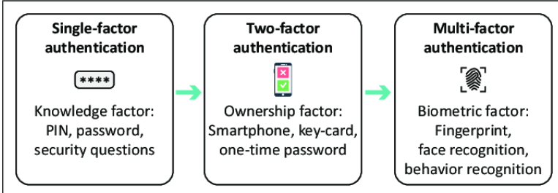
What is Authentication ?
Enables organizations to keep their networks secure by permitting only authenticated users .
Several authentication types
Single-factor authentication (SFA)
User ID and password
Two-factor authentication (2FA)
Additional authentication factors, such as a unique code (OTP)
biometric signature, like a facial scan or thumbprint
Multifactor authentication (MFA)
three or more identity verification factors are used for authentication
E.g. a user ID and password, biometric signature and perhaps a personal question the user must answer

Slide 6

What is Authorization ?
Authorization is the process of giving someone the ability to access a resource.
Authorization rules are part of an IT discipline called Identity and Access Management (IAM)
A good example is house ownership. The owner has full access rights to the property (the resource) but can grant other people the right to access it. You say that the owner authorizes people to access it.
Types Of Authorization
API keys
Basic Auth
HMAC (Hash-based Message Authentication Code)
OAuth

Slide 7
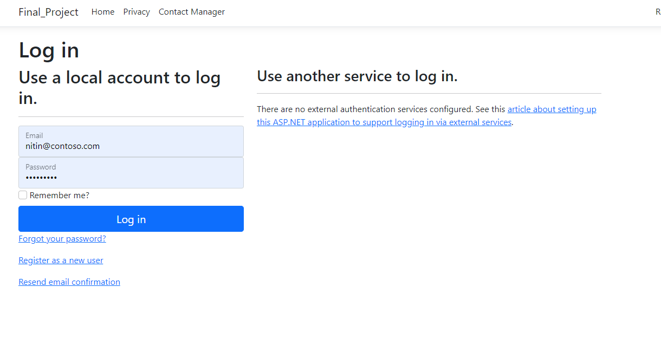
Administrative Login

Slide 8
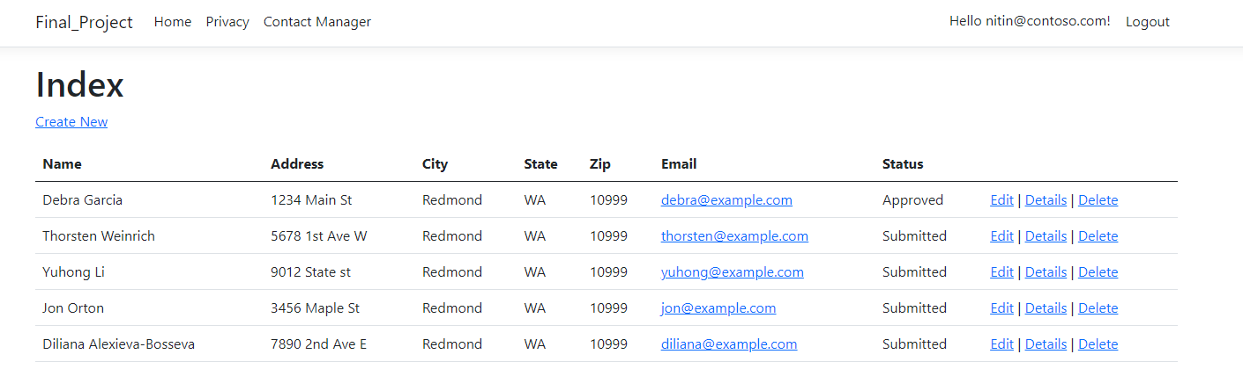
Administrative Login

Slide 9
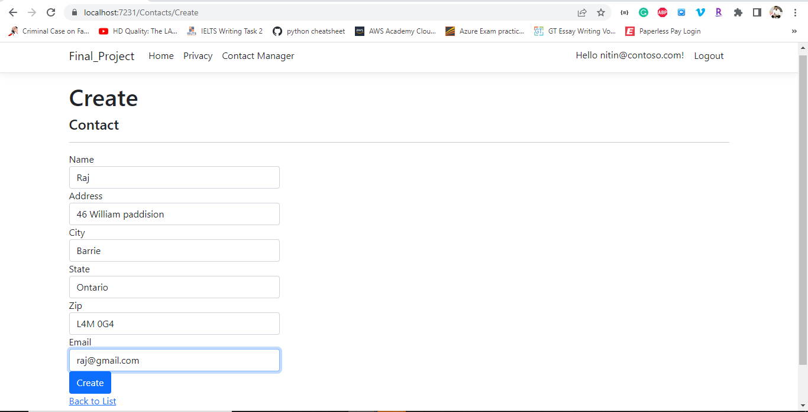
Administrative Create User

Slide 10
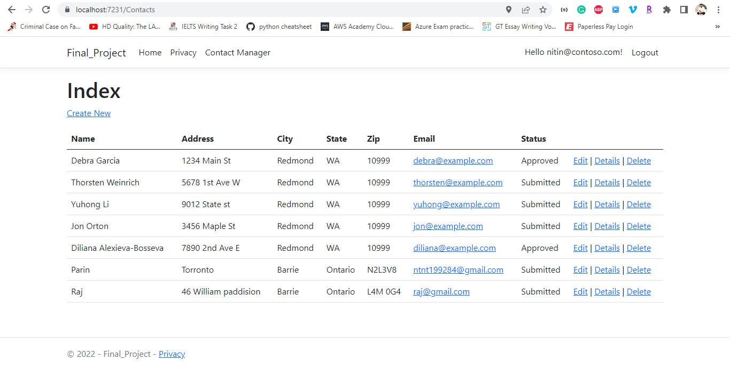
Administrative User List

Slide 11
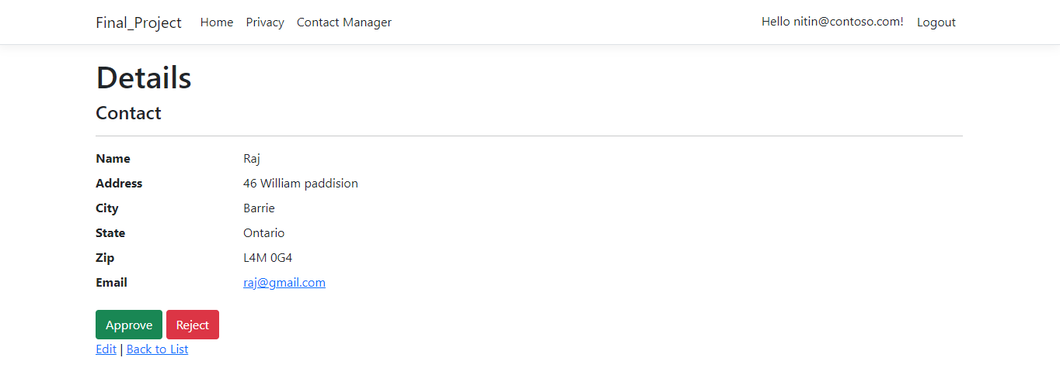
Administrative Approve/Reject

Slide 12
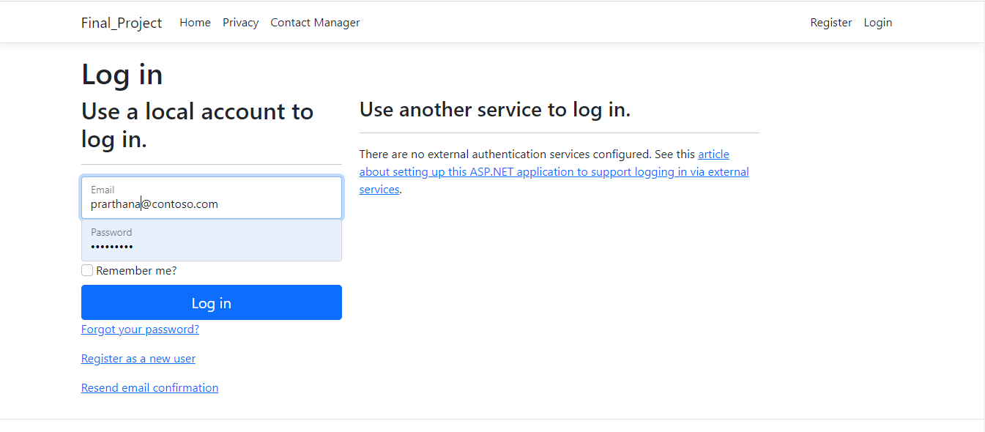
Manager Login

Slide 13
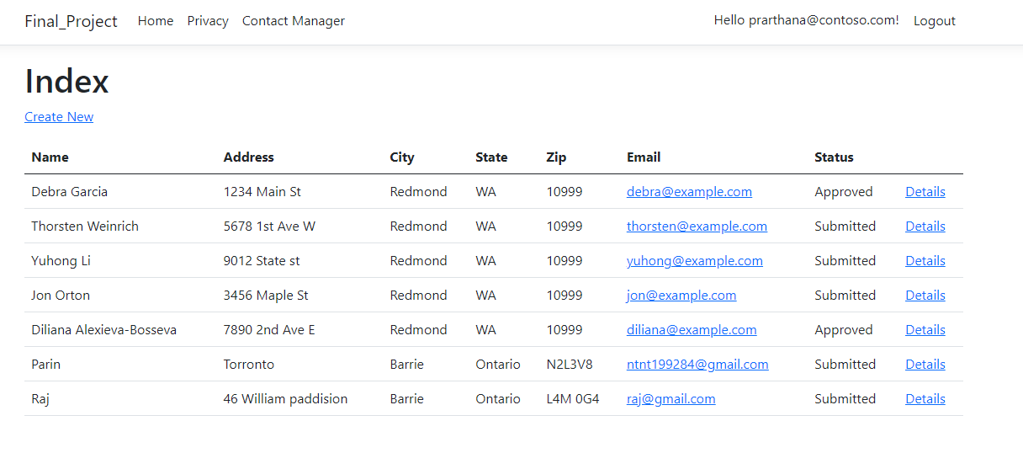
Manager User List

Slide 14
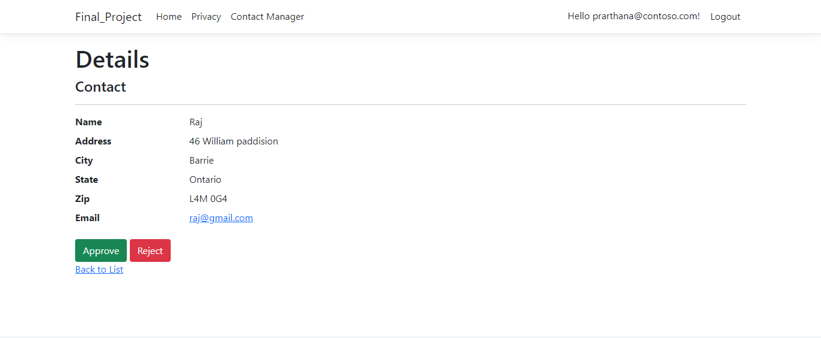
Manager Approve / Reject

Slide 15
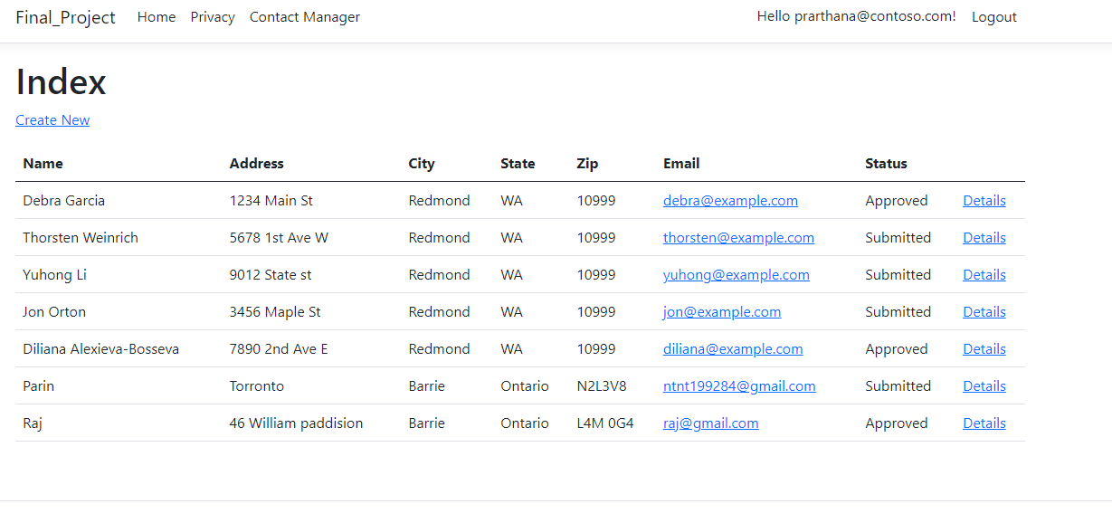
Manager Approved

Slide 16
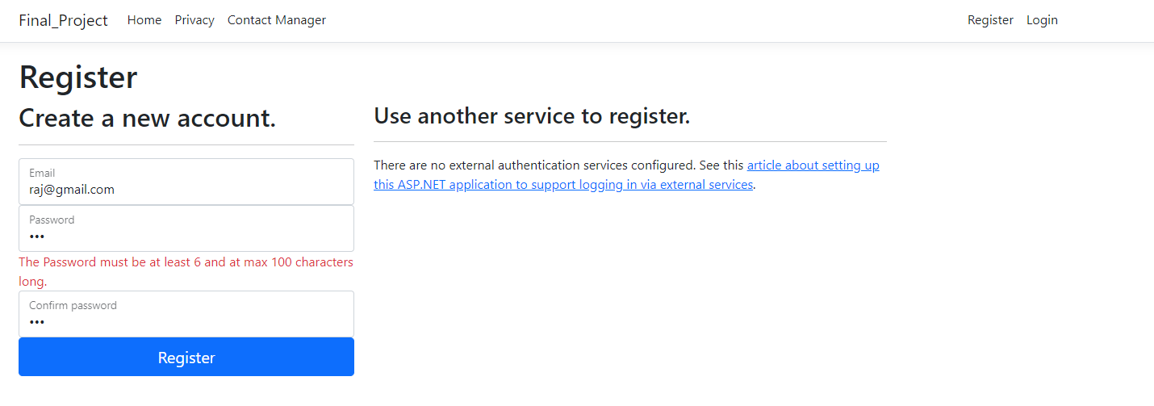
New User Registration Password Validation

Slide 17
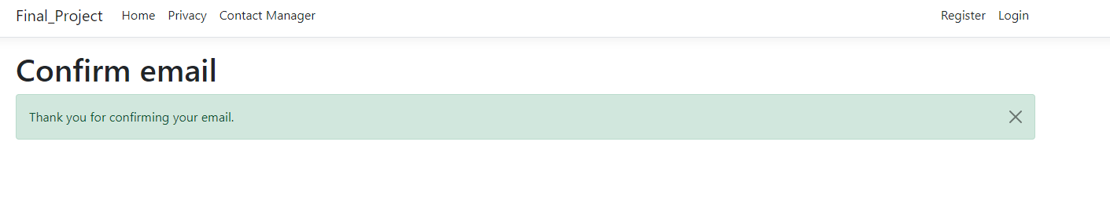
Confirm Email for New User

Slide 18
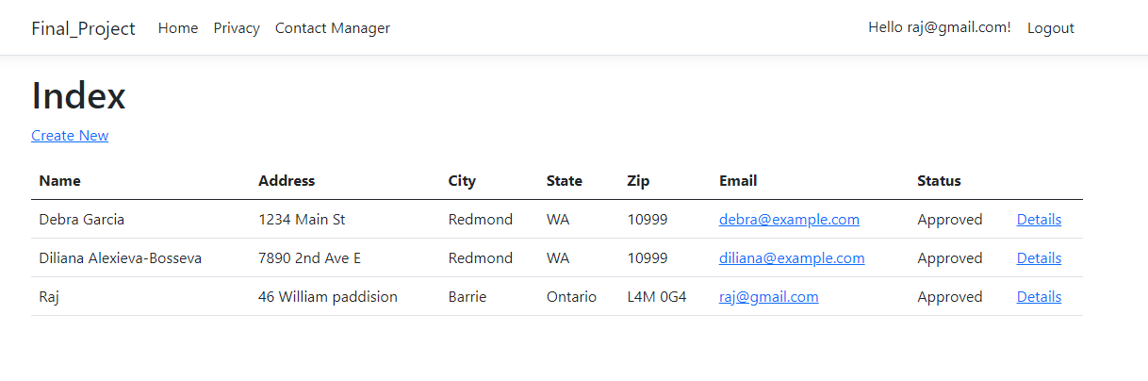
Registered User Access

Slide 19
Go to Actual Demo

Slide 20
Part 2: Security Technologies Recommendations

Slide 21
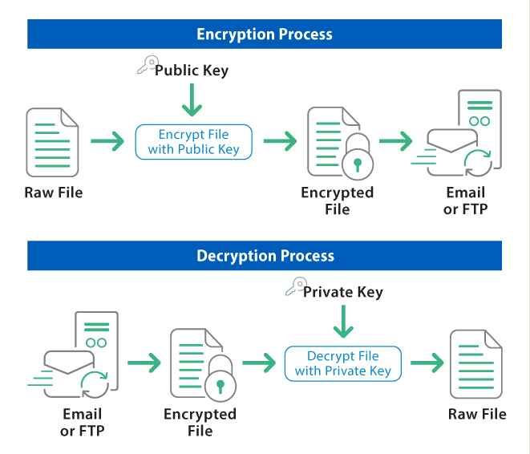
1. How can we transfer personal data securely within their network?
There are a couple of ways to transfer personal data within their network the safest way is by using Encryption along with the protocol.
So, sharing data using FTP protocol and using Encryption algorithms to transfer data within their network.

Slide 22
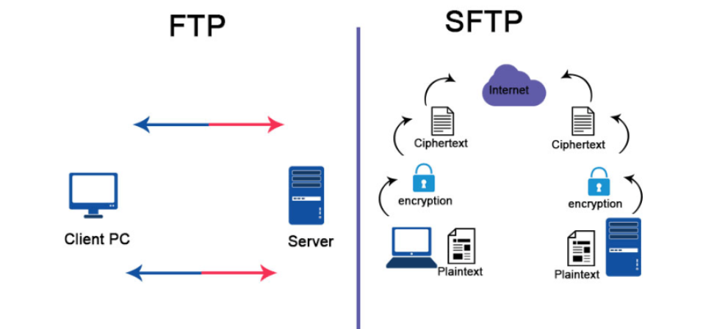
2. What security protocol is best for transferring personal files?
Previously the FTP was wildly preferred to transfer the data over the network then for more security purpose few new protocols were widely used for transferring personal file.
SFTP is a protocol developed by the Internet Engineering Task Force (IETF) and is probably the most widely used file transfer protocol today. SFTP utilizes Secure Shell encryption to encrypt transmitted data

Slide 23
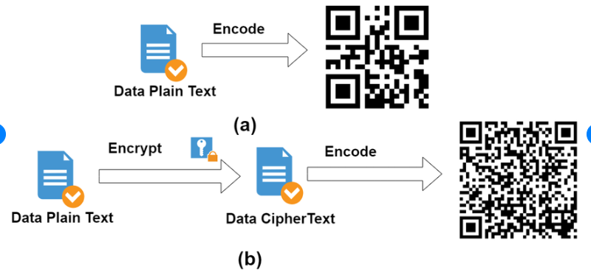
3. Can we encode and encrypt images?
Yes, We can encode and encrypt the images.
Usually, Images are encoded in Base64 formats.
In military the Steganography is a very well-known method for image encode and encryption. It hides the secret message in image.
QR code is another example of it.

Slide 24
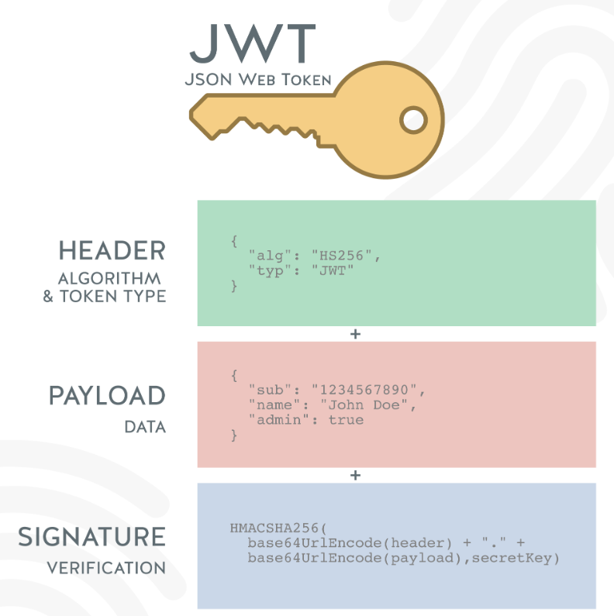
4. Our database cannot be moved from the site, and we need to be able to access it externally using a secure API. Can you explain the architecture of a secure API?
Using JSON Web Tokens (JWTs) in authenticating and authorizing API clients

Slide 25
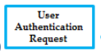


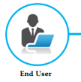
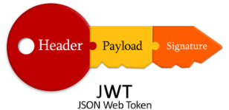
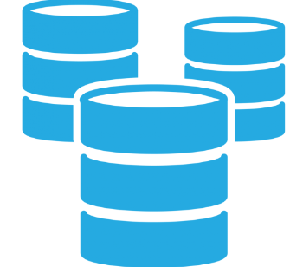
Architecture
DATABASE

Slide 26
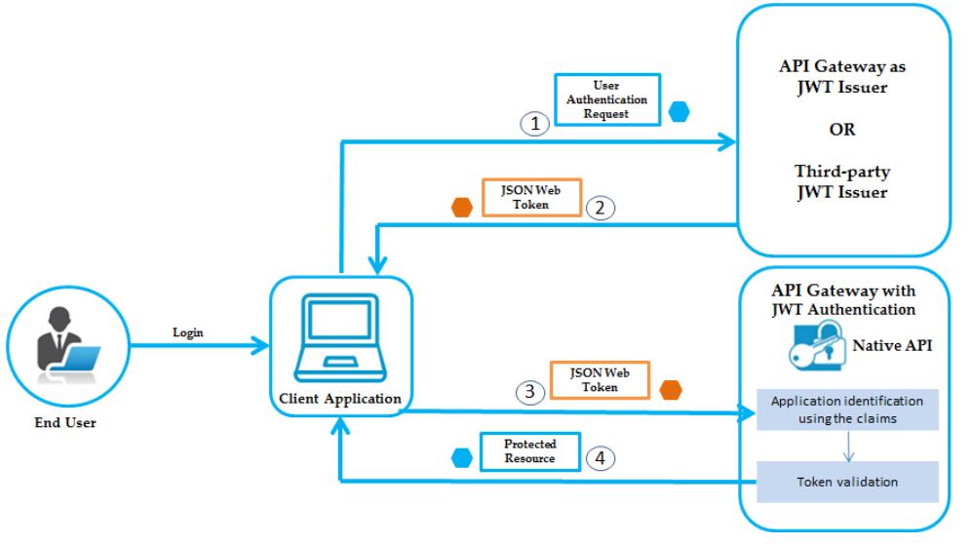
5. Can you recommend a secure framework for coding an API?

Slide 27

6. What data interchange format should we use while transferring data between locations?
There are many data interchange format available
XML
Text (CSV)
RDF
JSON

Slide 28
7. How should we store our data in our many locations?
To protect important data from loss or inappropriate disclosure, follow thing should be considered.
Store encrypted data on all devices
Store into more than one copy (Depends on data size and budget of an organization. Cloud is the best option)
Keep the data backup in encrypted form.

Slide 29

8. What are the ethical concerns related to the transmission of personal data?
Freedom from unauthorized access to private data(privacy rights)
Inappropriate use of data
potential for harm
Client Trust issue

Slide 30
Repository Link
Github Link : https://github.com/Nitin-Thakkar/ASP.Net-Authorization_and_authentication

Slide 31
